Slide 1

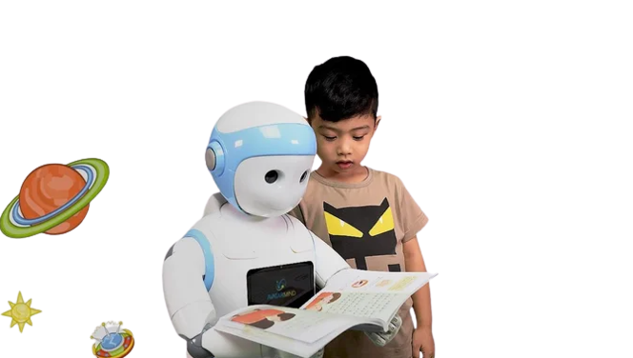

“And then what happens?”
Promoting Children’s Verbal Creativity Using a Robot
International Conference on Human-Robot Interaction
March 7-10, 2022, | Sapporo, Hokkaido, Japan
Authors:
Maha Elgarf
Cristopher Peters
KTH Royal Institute of Technology - Sweden
Natalia Calvo-Barajas
Ginevra Castellano
Uppsala University - Sweden
Ana Paiva
University of Lisbon - Portugal
Patrícia Alves-Oliveira
University of Washington - United States
Giulia Perugia
Edindhoven University
of Technology – Netherlands
___________________________
This presentation:
University of Aveiro
Human-Computer Interaction [2022/23]
João Pedro Nunes Vieira - 50458
Beatriz Agante de Almeida - 93418

Slide 2

Table of Contents
1. Introduction
Reasons
Focus
Previous Work
Contributions
2. Methodology
RTF
Instruments
User Sample
Envioment
3. Analysis
Hypotheses
Data Treatment
Results
4. Conclusions
Discussion
Opinions
Let's Play!

Slide 3
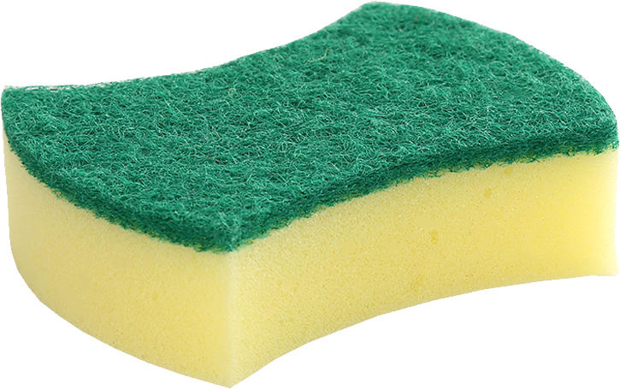

Why this paper?
Children are:
Important Users
The future
Stakeholders

Slide 4

Research Focus
Creativity:
Highly prized trait in the 21st century.
Facilitates:
Critical thinking
Self-expression
Communication

Slide 5
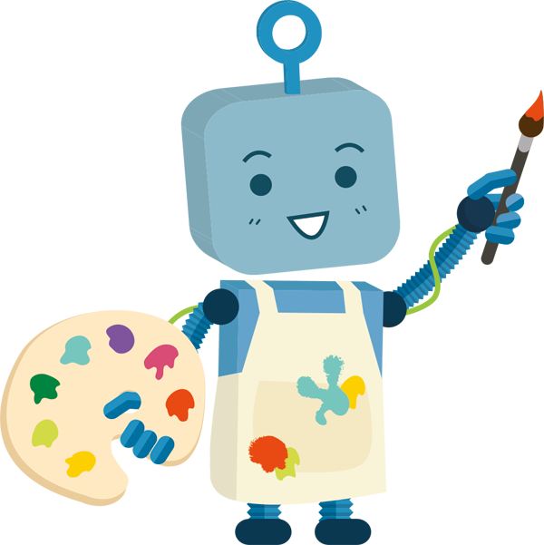
Previous Work
Robots with creativity skills:
Prompt children to be more creative!
Children’s creativity is influenced:
The activity
Environment
Robot’s behaviors

Slide 6

Previous Work
The literature is still inconclusive!
Some studies → Positive moods enhance creativity more.
Other studies suggest → The opposite.
“While creativity has been previously studied in Child-Robot Interaction(cHRI)…
…the effect of Regulatory Focus on creativity skills has not been investigated.”
Crucial:
The way robots’ behaviors and creativity tasks are designed.

Slide 7
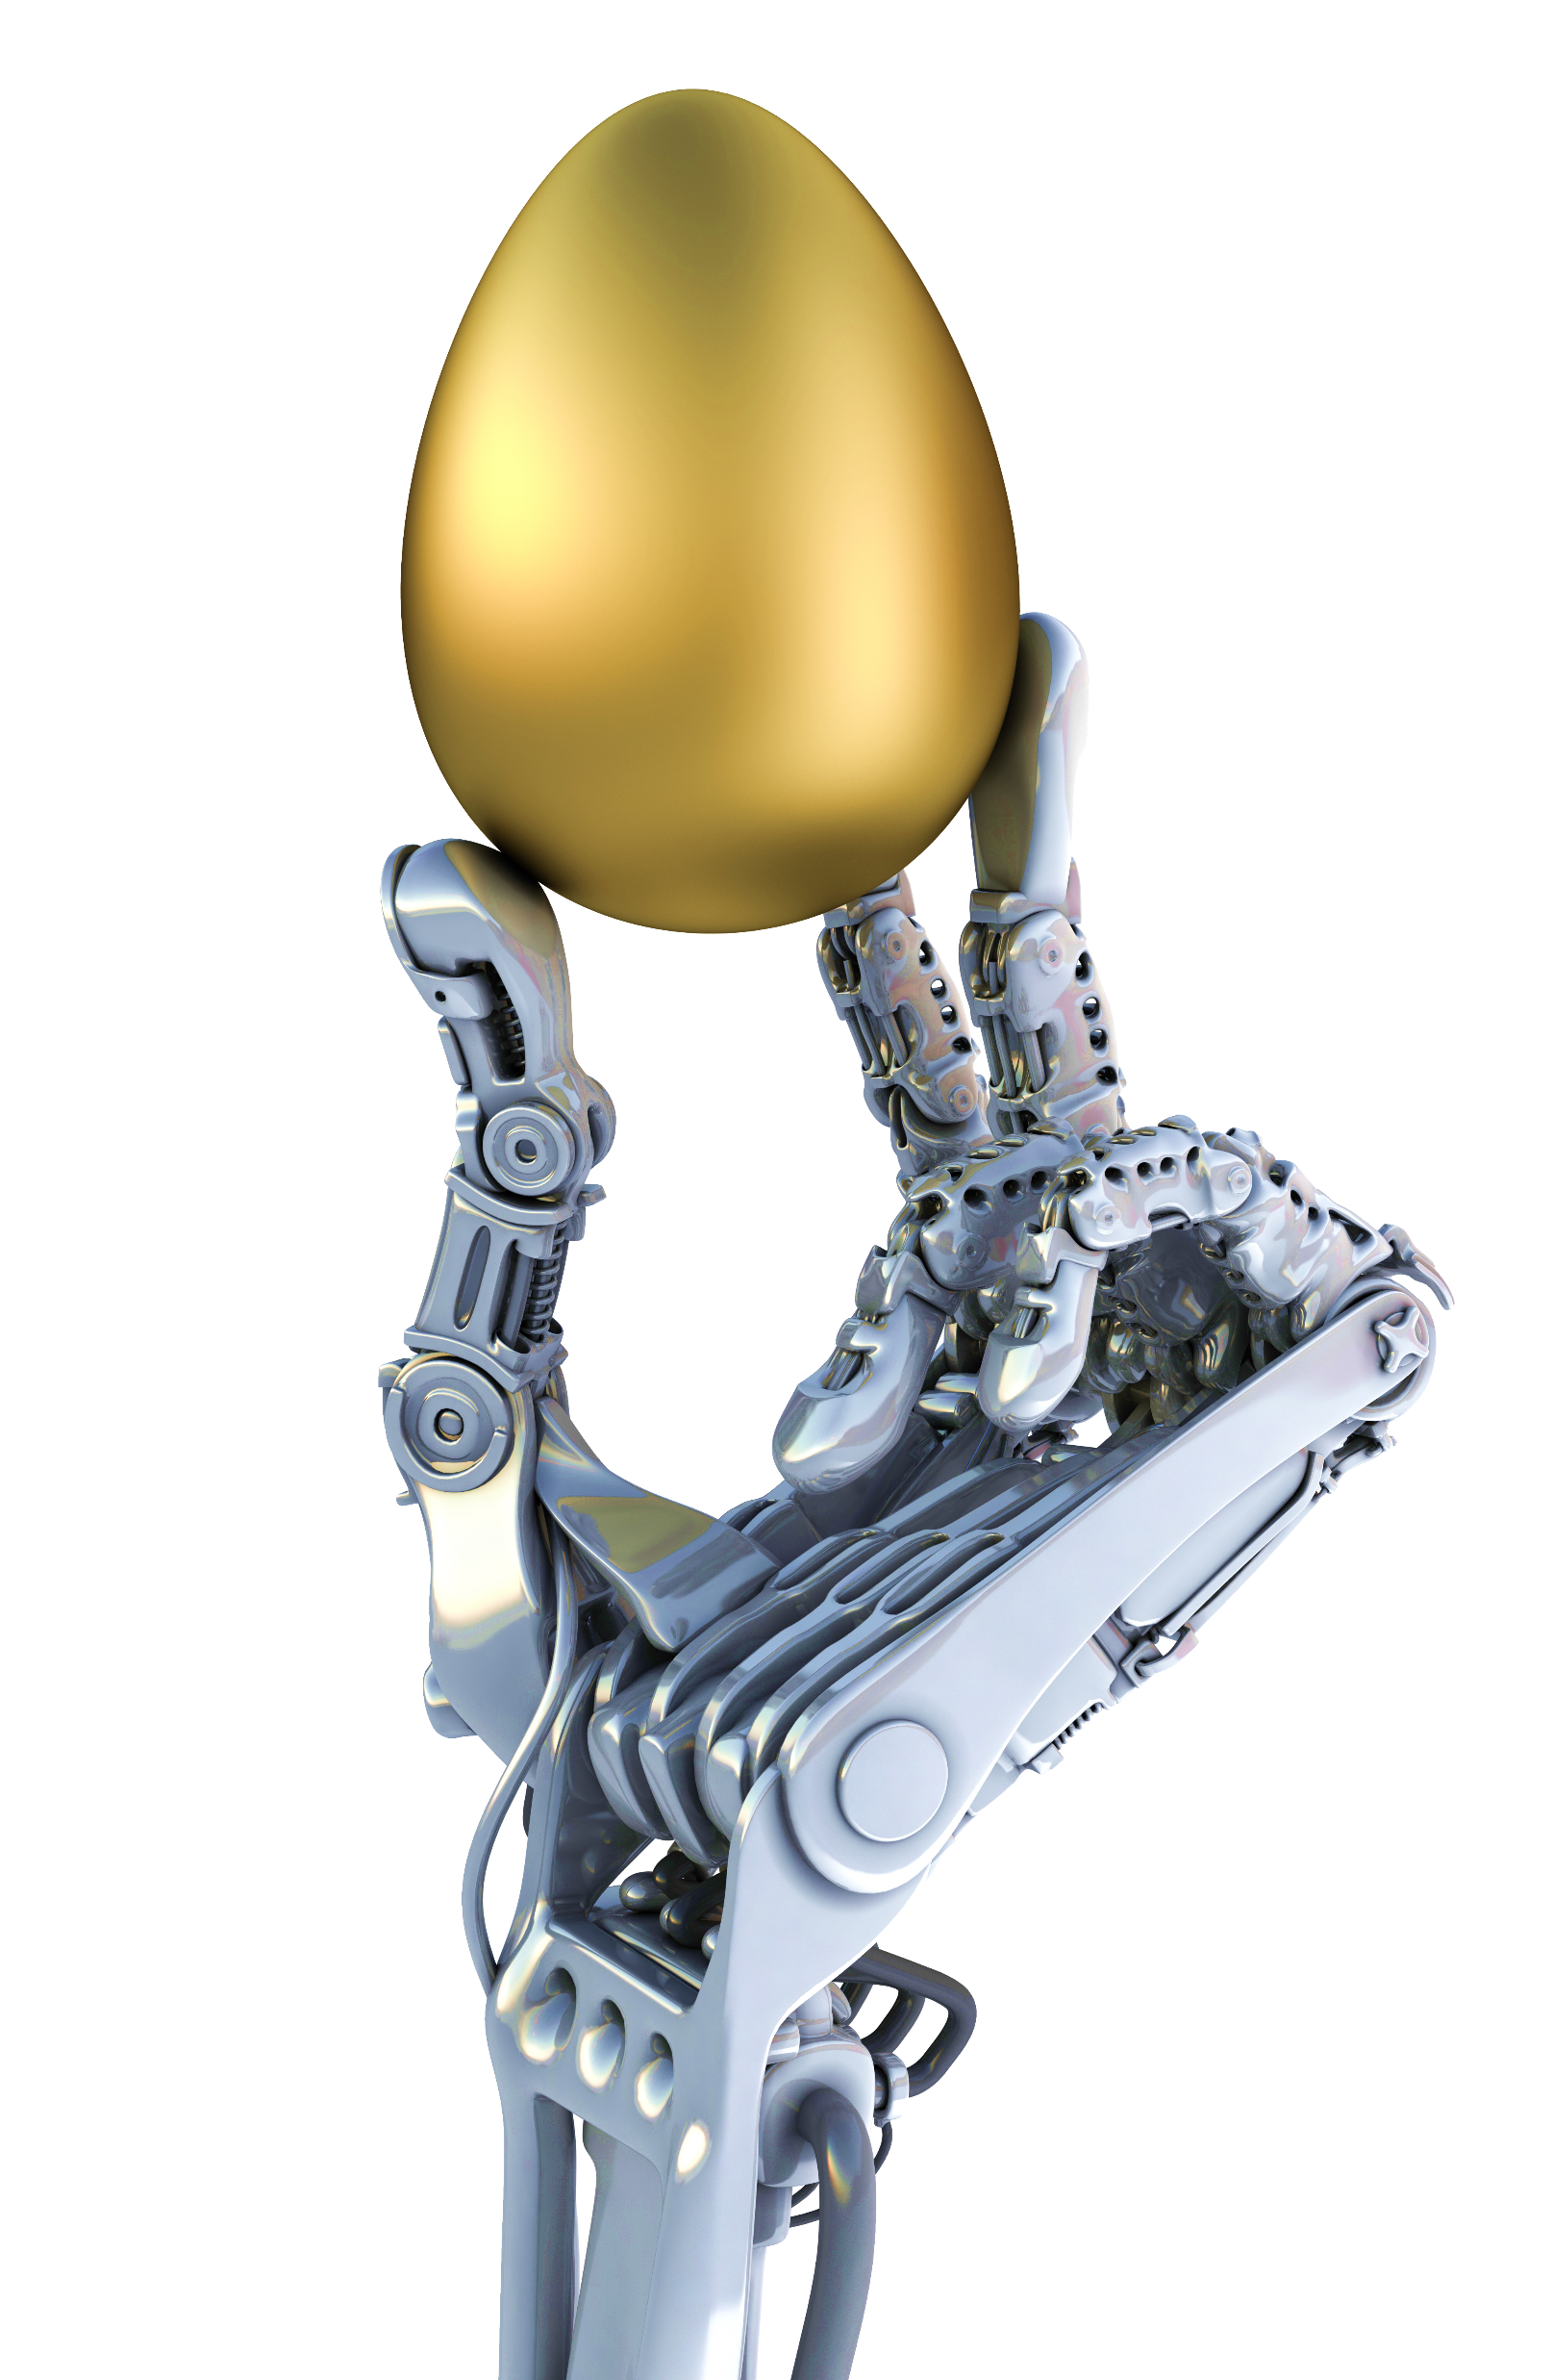
Contributions
Investigate effectiveness of social robots in stimulating children.
Pioneer study! Provide empirical evidence and investigate children’s verbal creativity using RFT
Provide new insight into robot behavior design regarding creativity.

Slide 8

Regulatory Focus Theory
How people pursuit their goals!!!
Two motivational approaches:
Promotion - anticipation of positive outcomes:
[ Excitement → Happiness(GOAL) ].
Prevention - avoidance of negative outcomes:
[ Fear → Relief(GOAL) ]
Prof. E.Tory Higgins

Slide 9
Methodology
Collaborative storytelling game – cHRI
Two experimental conditions:
Promotion vs. Prevention
2x2 mixed experimental design:
Priming stages
Storytelling activities

Slide 10


Priming
Verbal behaviors:
Suggest happiness and excitement [Promotion]
Suggest fear and anxiety [Prevention]
Non-verbal behaviors:
Robot’s facial expression to exhibit emotions.

Slide 11

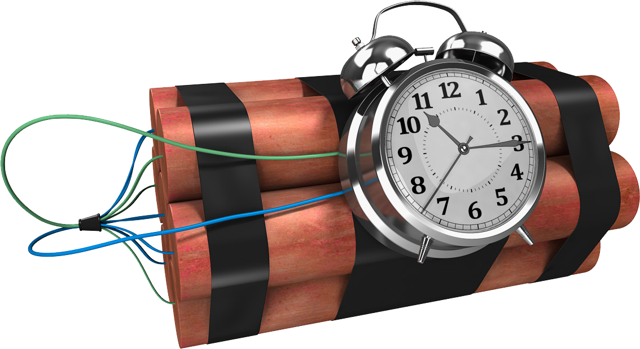
Priming
Scenario:
You’re locked with the robot in a spaceship on Mars.
Collaborate and find the Key! (ensured)
Promotion condition:
Reward-seeking game (Gift: Party on planet Mars)
Prevention condition:
Risk-avoidance (No Gift: Just land on Mars).

Slide 12
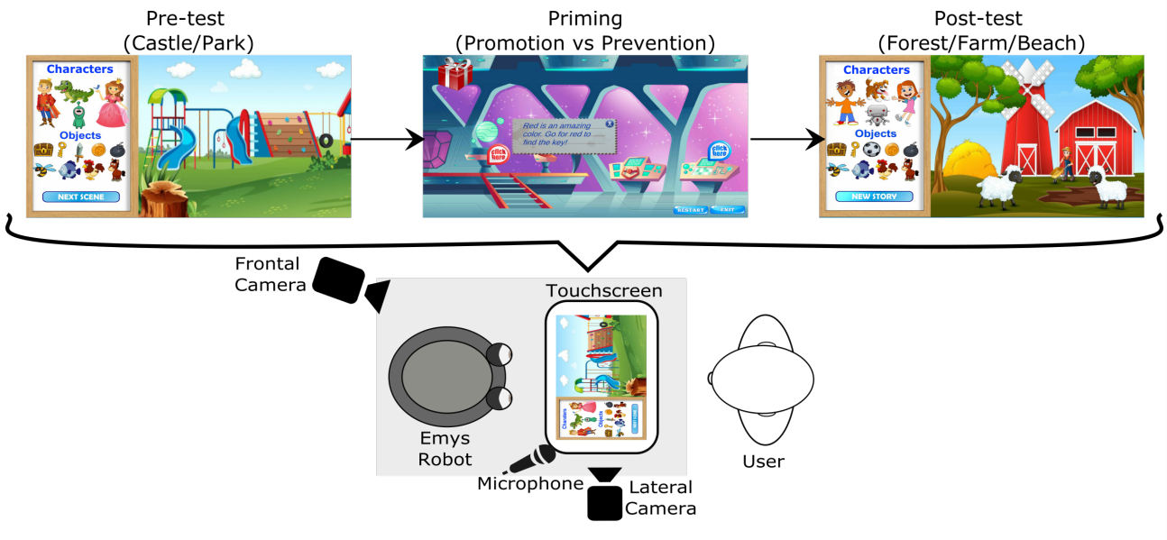
Storytelling
Two collaborative games between the child and the robot:
Before and after the priming activity
The activity's purpose was to determine if priming
affected children’s narrative creativity levels
Activity itself:
Main goal: Create and tell a story to the robot
Each had 4 main characters and 9 objects
Graphical User Interface (GUI)

Slide 13
Storytelling

Slide 14

Instruments
EMYS: Robotic agent + Tablet + Microphone + Columns
Non-Verbal Behaviors: (default)
Expresses emotions through facial expressions.
Verbal Behaviors: Wizard of Oz [Text-to-speech]
In the priming: strict protocol (RFT)
In the storytelling sessions: generate verbal behavior

Slide 15
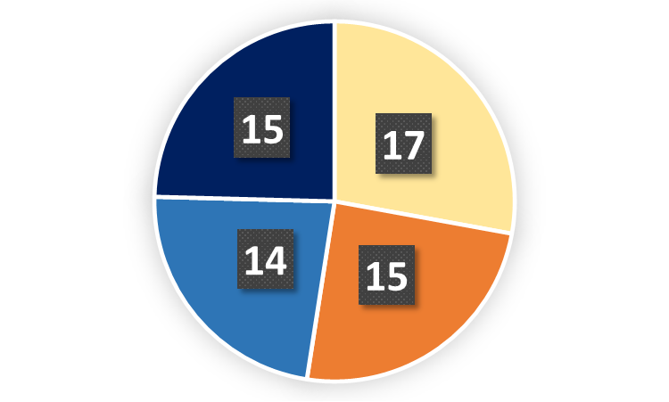
User Sample
69 children but 8 were excluded:
Age: 7 - 9 years
Language: English
Scholarship: 2nd & 3rd grades
Consent: signed by Legal Guardians
Promotion (Top): 32 children (15 boys, 17 girls)
Prevention (Bottom): 29 children (14 boys, 15 girls)

Slide 16
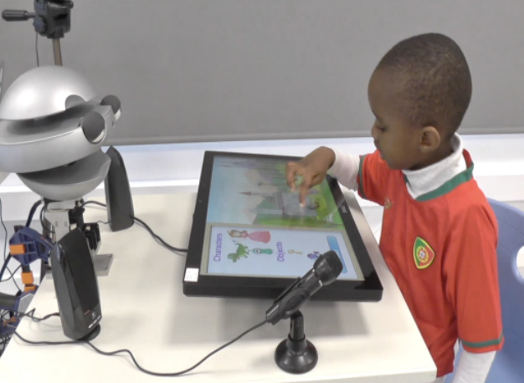
Enviroment
Interaction:
.
Time: 2 weeks
Place: 2 private schools
Operators: 2 researchers

Slide 17

Hypotheses
H1: Children in the promotion condition could perform better in verbal creativity than those in the prevention one
H2: When the robot showed encouragement or asked questions to children, their creativity levels would increase

Slide 18

Data Treatment
Behavior analysis:
From each child, there was an audio file of the experiment
Facial expressions:
From the frontal camera, an analysis was run with Affectiva
Intellectual analysis:
Children had their creativity evaluated

Slide 19
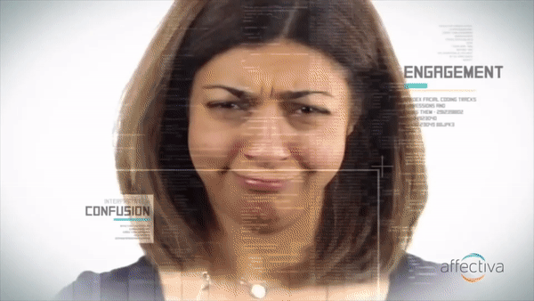
Results
Facial expressions:
Children in the promotion condition experienced more smiles and joyful expressions than those in the prevention condition.

Slide 20
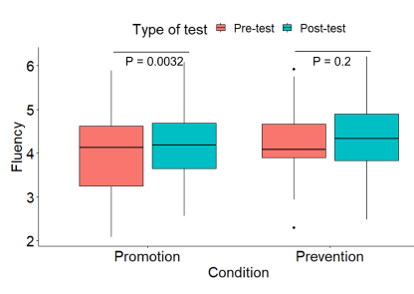
Results
Effect of RFT Design on Children's Creativity:
Creativity was measured in Fluency,
Flexibility, Elaboration and Originality
Fluency: children in the promotion
condition exhibited higher fluency of
ideas in the post-test than in the pre-test

Slide 21
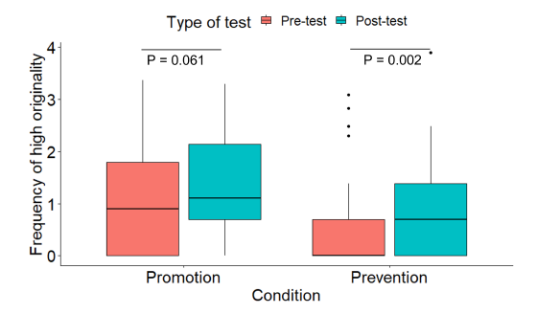
Results
Effect of RFT Design on Children's Creativity:
Originality: in the prevention condition,
the frequency of originality at the
high level was significantly higher
in the post-test than in the pre-test

Slide 22
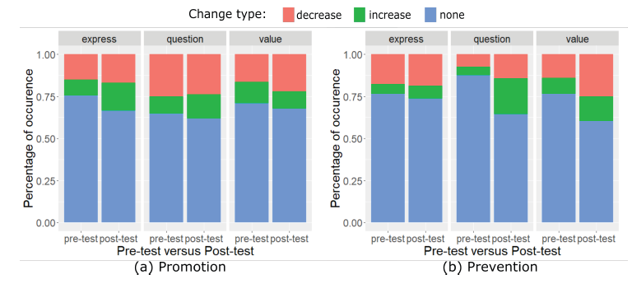
Results
Effect of the Robot's Verbal Behavior on Children's Originality:
Three types of robot's behaviors that were used during the storytelling activity
What happened?
The robot’s verbal behaviors tended to slightly decrease originality rather than increase it

Slide 23
Results

Slide 24

Discussion
Effect of RFT Design on Children's Creativity:
The experiment was able to confirm that inducing happiness results in higher creativity in children
As well as high potential of engaging in a collaborative activity with a robot to stimulate children's creativity

Slide 25
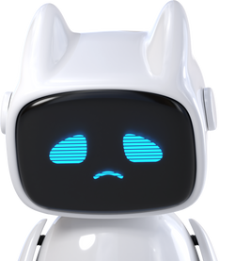
Discussion
Effect of the Robot's Verbal Behavior on Children's Originality:
The robot’s verbal behaviors tended to slightly
decrease originality rather than increase it
Children perceived the behavior of the robot
as an interruption in their line of thought

Slide 26

Opinions
Harsh punishments (like yelling) that induce fear are counter productive.
Inducing fear in children may not be as motivating as inducing fear in adults (problem solving).
Interruption of train of thought.
Fight or Flight.
More investigation needed

Slide 27

Lets play!
To give you a better idea of the experiment, we provide a little game we designed 😊
Try it at https://biagante.github.io/
There are some bugs, but we hope you have fun!
For better viewing, use the desktop appearance.

Slide 28

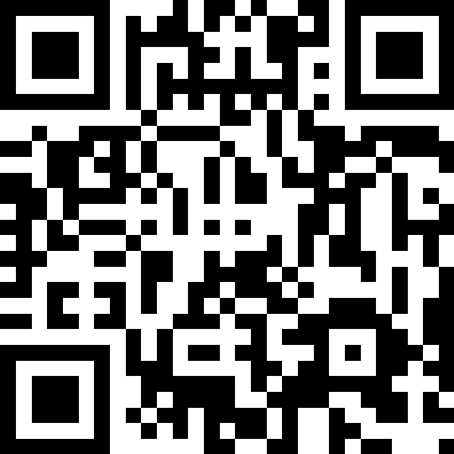
Resources & Bibliography
https://www.pngwing.com
https://rb.gy/ed97q
https://youtu.be/eUzXNxvAsgg

